Slide 1
D.Eco Sprint 4
Fiasal Alsabahn, Cory Harris, Morgan Brown, Kylie Pfaff

Slide 2
Sprint 3 Completion
Slash Screen
View Trees on Campus
View/Read about Trees
21 Tree Tour
Admin Page
Navigation Button
D.Eco – January 19, 2018

Slide 3
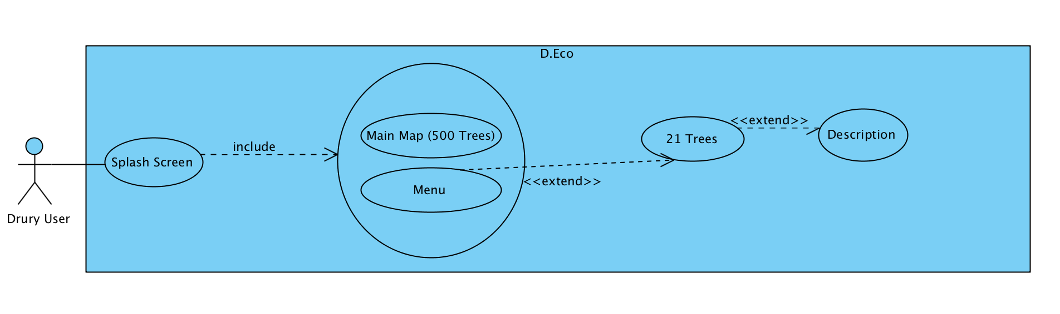
Sprint 4 Use Case Diagram

Slide 4
Sprint 4 Acceptance Plan
 | Requirements | Completion
Menu | X | X
21 Tree Description Page | X | X
Move Admin to EC2 | X | X
Tree Image on Description | X | X
List Views | X
Image Upload/Descriptions for Admin Page | X | X
Restructure DB |  | X
D.Eco – January 19, 2018

Slide 5

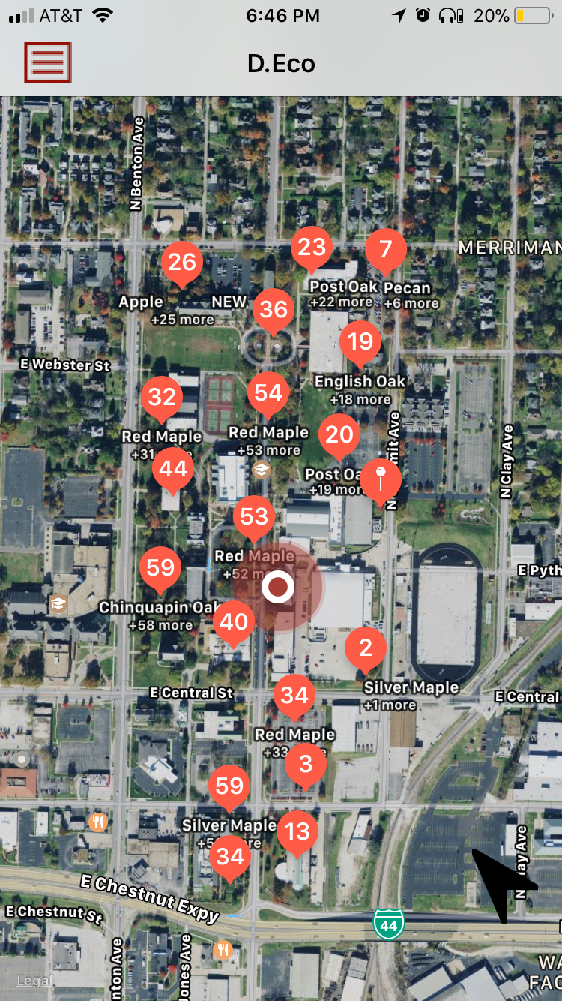
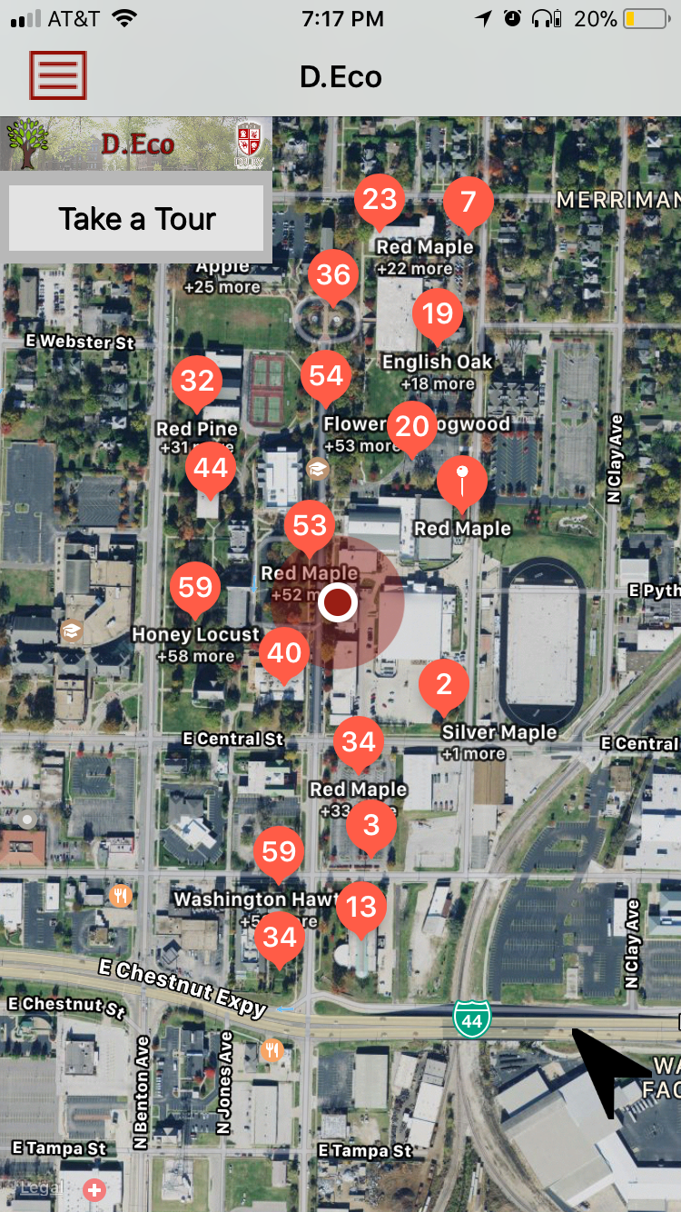
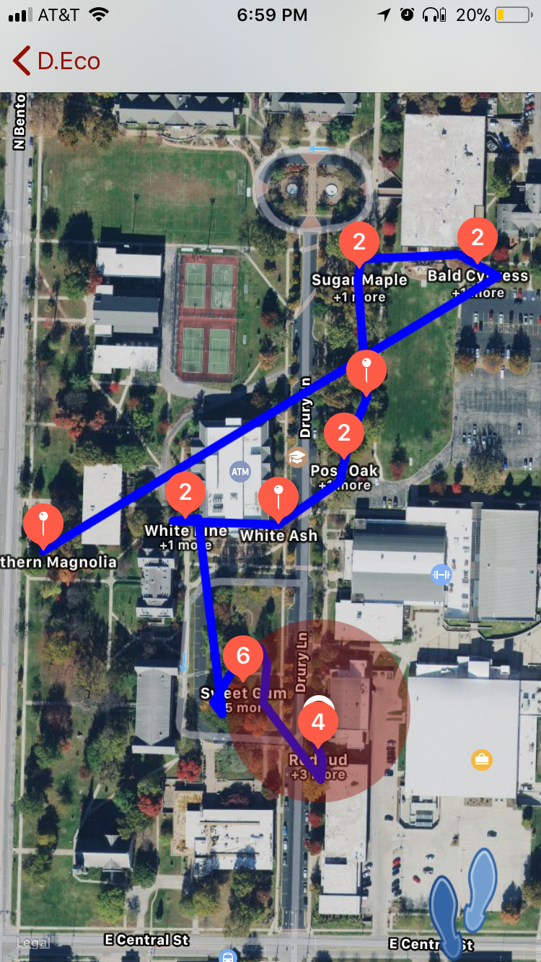
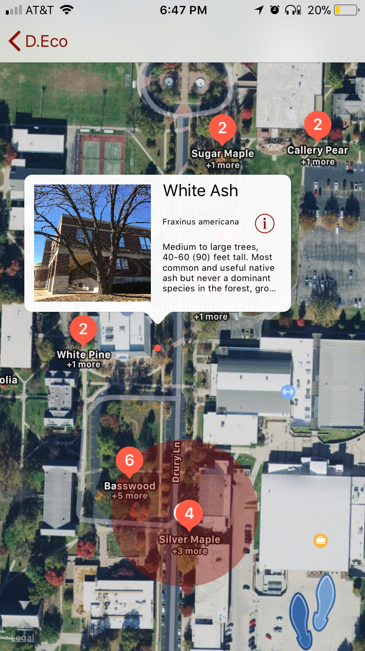
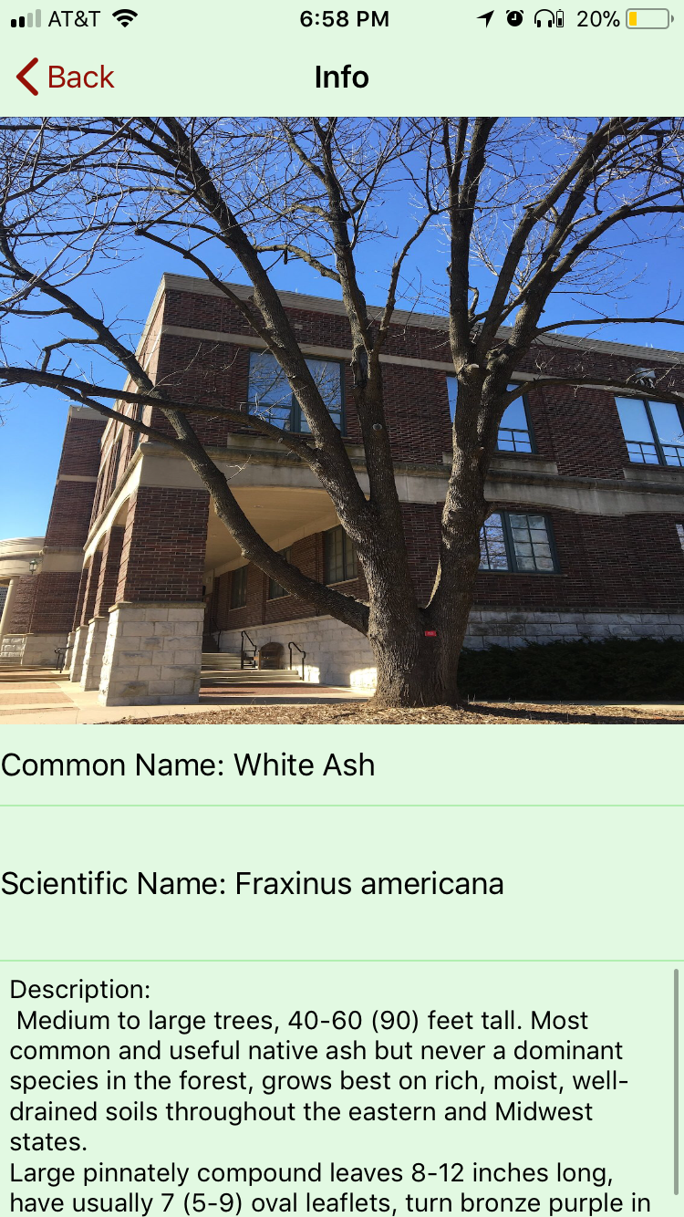
User Interface - iOS
Splash Screen
Tree Map (559)
Main Menu
21 Tree Tour
Description
Description
D.Eco – January 19, 2018

Slide 6

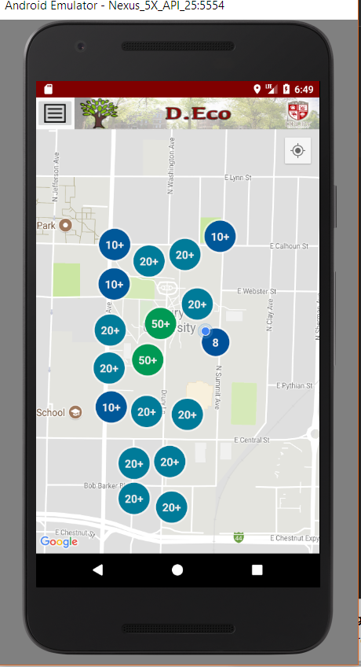
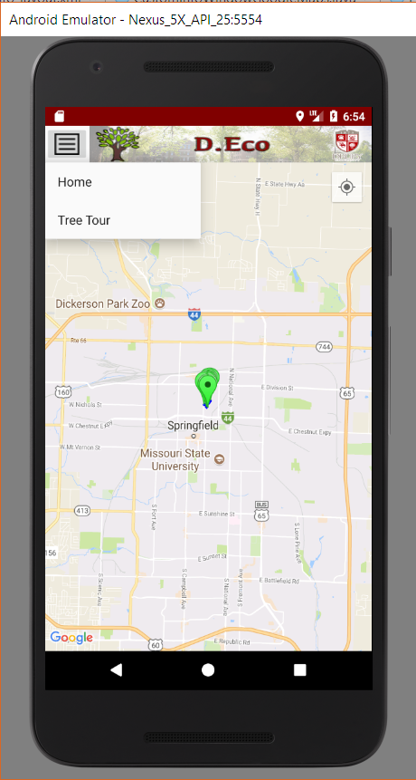
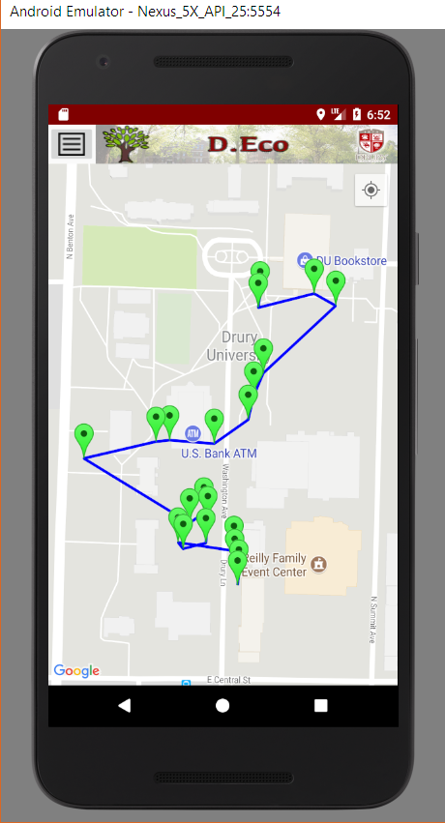
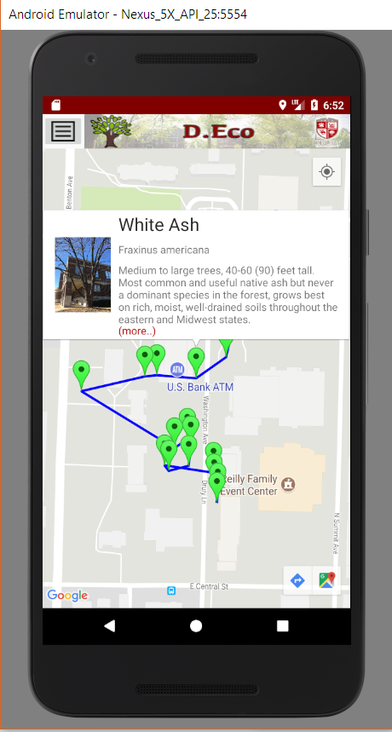
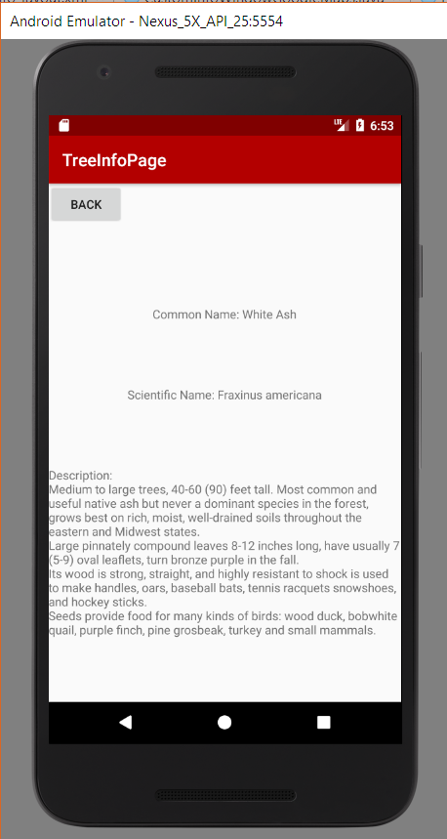
User Interface - Android
Splash Screen
Tree Map (559)
Menu
21 Tree Tour
Description
Description
D.Eco – January 19, 2018

Slide 7
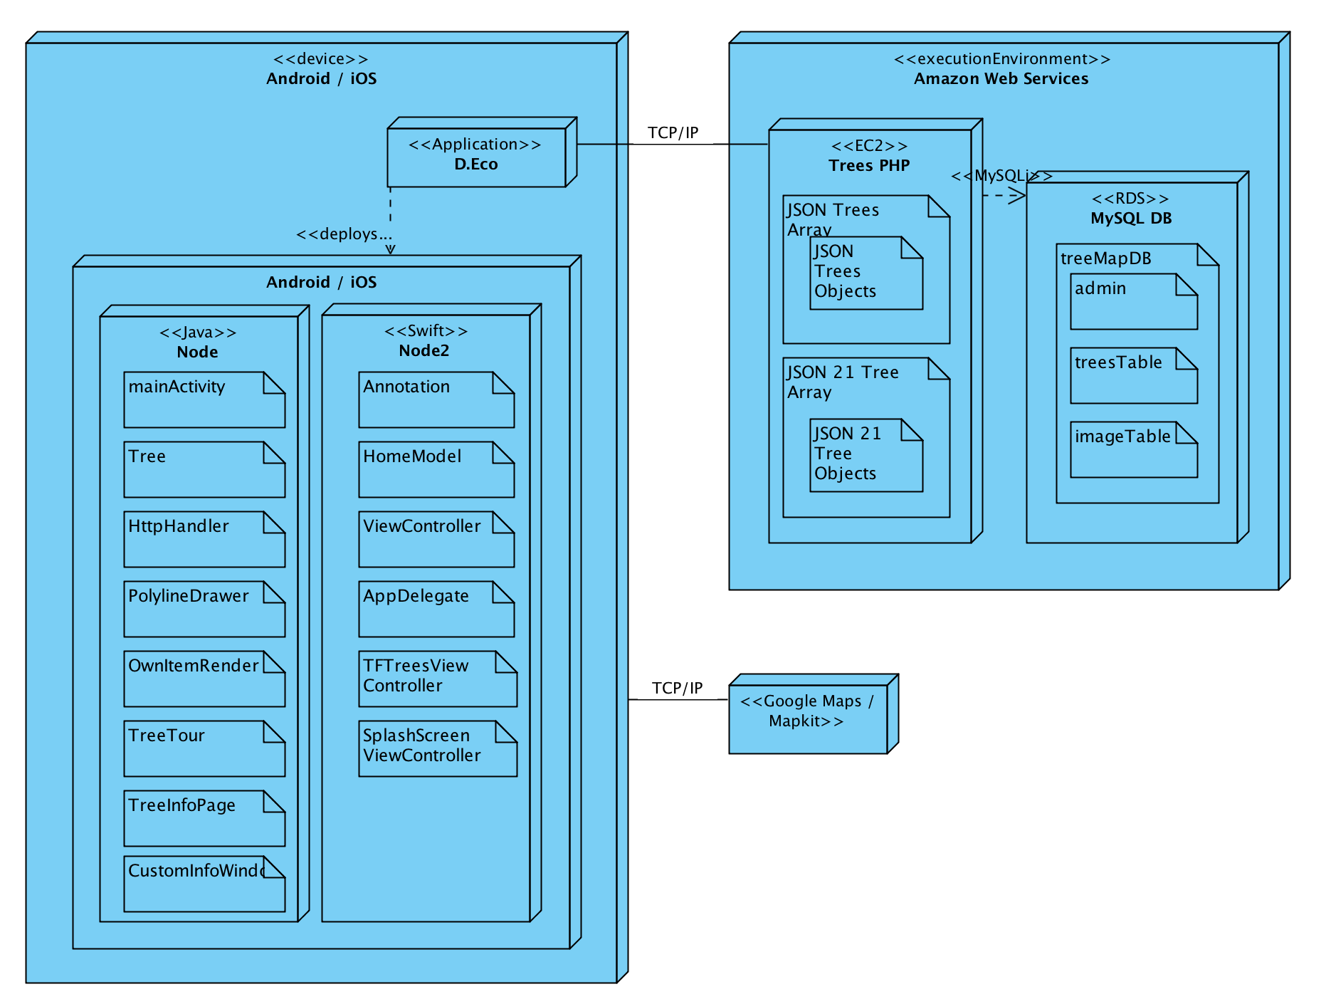
Architecture
D.Eco – January 19, 2018

Slide 8
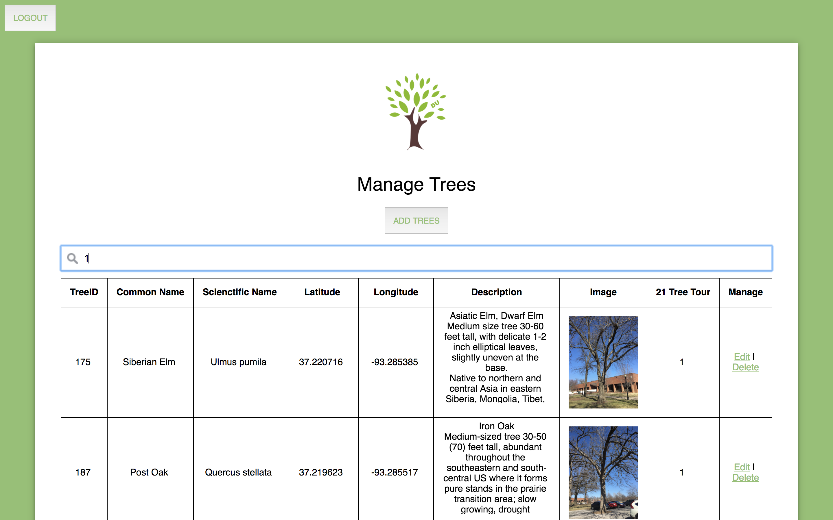
Admin Page
D.Eco – January 19, 2018

Slide 9
Product Transition Plan
User Testing (Bio Students) by April 2, 2018
Move AWS scripts to Drury owned AWS by April 27, 2018

